Slide 1
Please fill out the following form:
https://forms.gle/EvpHcuJXBzh3ukYp9

Slide 2
CSE514 – Datamining Fall 2022 Decision Trees
Cynthia Ma
Department of Computer Science
Washington University in St. Louis
czma@wustl.edu

Slide 3
Quick admin follow-up
Grading goals:
Exam 1 CNN EC is posted
Exam 1 DM steps EC posted by Friday
Exam 1 posted by next Monday
Programming Assignment 1 posted by next Wednesday
Lecture recordings

Slide 4
Decision Tree Components
Parent
Root
Children
Leaves

Slide 5
Building a Decision Tree
Starting at the root, pick an attribute/feature to split the training data into subsets
Height > 5ft, True or False
Hair = Brown, True or False
Repeat picking splits on each child node until
All data points in a subset are similar enough
There are no more features or attributes to split with

Slide 6
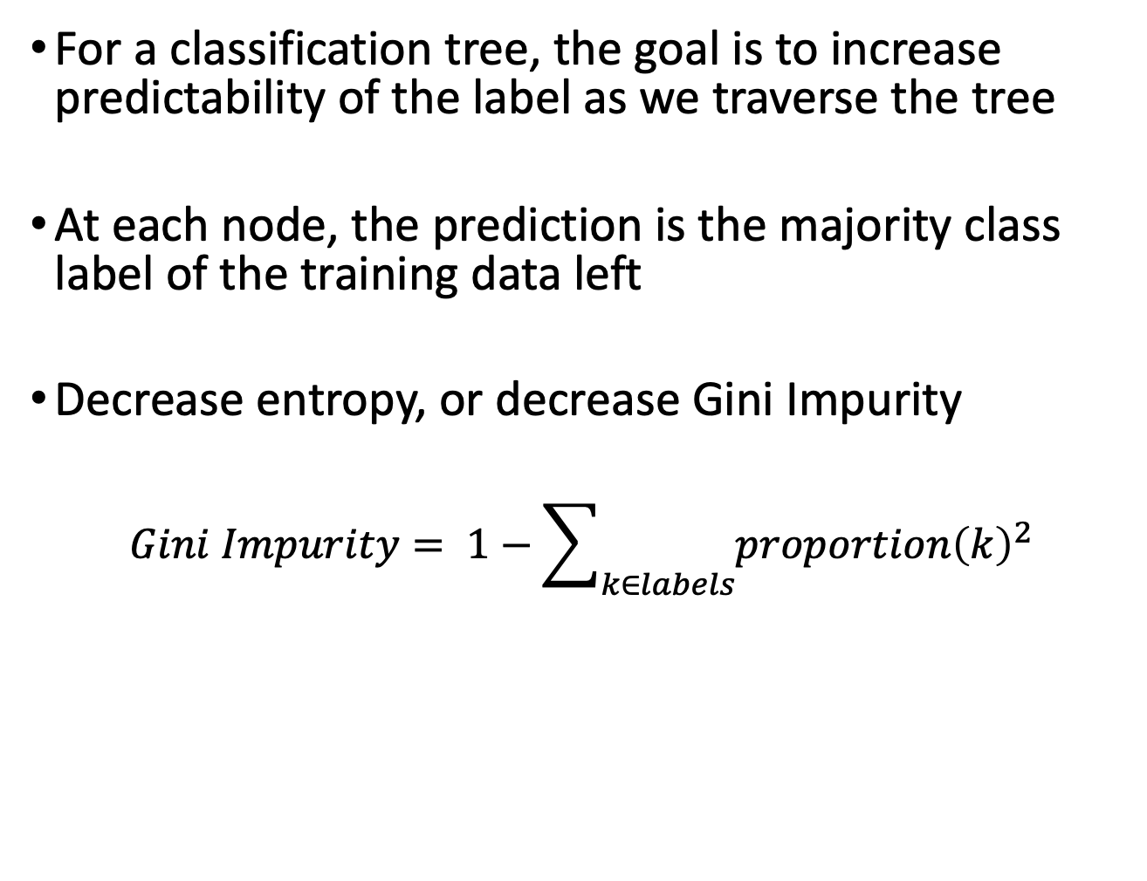
Building a classifier
For a classification tree, the goal is to increase predictability of the label as we traverse the tree
At each node, the prediction is the majority class label of the training data left
Decrease entropy, or decrease Gini Impurity
$$Gini Impurity= 1−\sum_{k∈labels}{{proportion\left(k\right)}^{2}}$$
Notes:
병찬
엔트로피, 지니: 높다는건 막 섞여 있음, 순도가 낮다
엔트로피, 지니: 낮다는건 그닥 안 섞여 있음 순도가 높다
Gini 도 줄여야지 좋은거다
데이터가 불순할수록 얻을수 있는 정보가 없음(1에 가깝다)
데이터가 순수할수록 얻을수 있는 정보가 많음(0에 가깝다)
지니(불순도) 높을수록 데이터 분산(섞여)되어있음
낮다는건 데이터 집중되어 있음

Slide 7
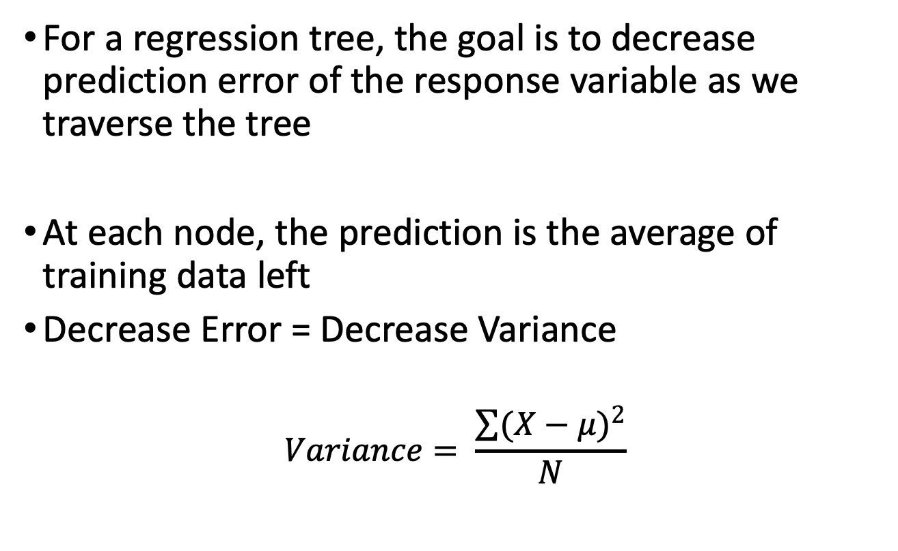
Building a regressor
For a regression tree, the goal is to decrease prediction error of the response variable as we traverse the tree
At each node, the prediction is the average of training data left
Decrease Error = Decrease Variance
$$Variance= \frac{\sum{{(X−μ)}^{2}}}{N}$$
Notes:
병찬
여기서도 분류문제이면 다수를 선택
리그레션 문제이면 평균을 선택

Slide 8
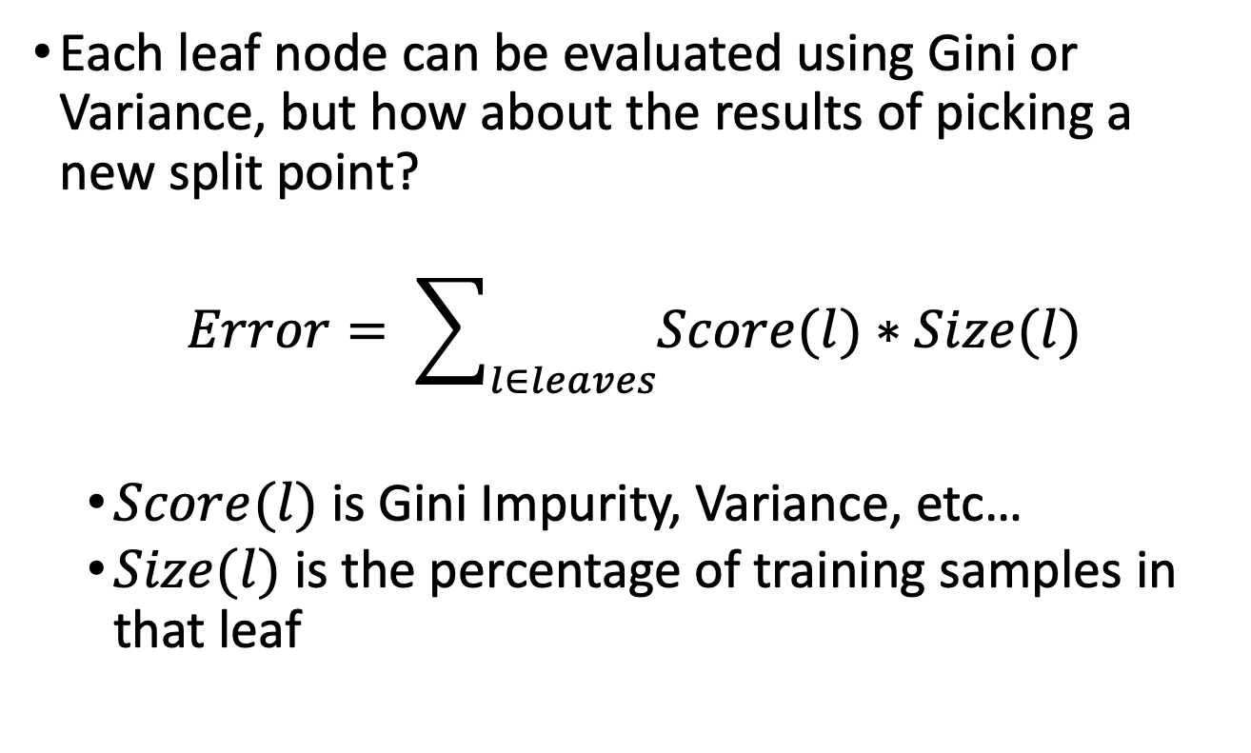
Evaluating a set of leaves
Each leaf node can be evaluated using Gini or Variance, but how about the results of picking a new split point?
$$Error= \sum_{l∈leaves}{Score(l)∗Size(l)}$$
$Score(l)$ is Gini Impurity, Variance, etc…
$Size(l)$ is the percentage of training samples in that leaf
Notes:
병찬,
결국 여기서도 트리를 평가를 해야 하는데 그걸 배운다.

Slide 9
Decision Tree example
https://forms.gle/EvpHcuJXBzh3ukYp9
What’s the best split for predicting percentage of t-shirts that are white?
What’s the best split for predicting blue is liked more than red?

Slide 10
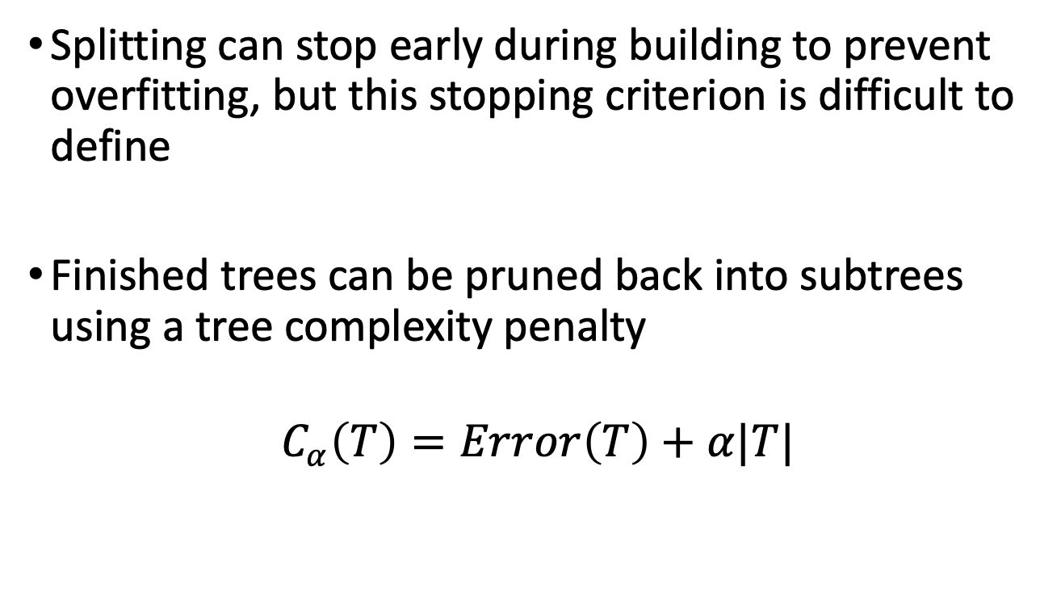
Tree pruning
Splitting can stop early during building to prevent overfitting, but this stopping criterion is difficult to define
Finished trees can be pruned back into subtrees using a tree complexity penalty
$$C_{α}\left(T\right)=Error\left(T\right)+α|T|$$
Notes:
병찬
|T| = size of tree = number of leaf nodes, 사이즈 나타냄
알파(a) = 러닝 레이트랑 비슷.

Slide 11
Ensemble Learning
Train multiple models
Predict with all trained models
Combine predictions to make a better final prediction

Slide 12
Stacking
Stacked generalization
Train all component models on the training data
Train a combiner model that uses the output of component models as input for making a final prediction
A common application is to fit a linear regression model to learn how much to weigh each model’s prediction before summing up to make a final prediction

Slide 13
Bagging
Short for Bootstrap Aggregating
Create new training data of the same size by sampling with replacement (bootstrapping)
Fit a model with the bootstrapped dataset
Repeat to create many models
Predict using a fair voting scheme across models

Slide 14
Bootstrapping motivation
The true state of the distribution our data comes from is unknown, we only have a sampling of it
If we re-sample from our dataset
We create a sampling of a known distribution
We create a dataset with a new sampling bias
Ex. We sample to find average height of college students
How likely is it that the average would be different if we sampled different people?
Bootstrap with replacement to create new samplings of the same size – how variable are the averages?

Slide 15
Random Forest
Generate a bootstrapped dataset
Datapoints that don’t appear at all are “Out-of-bag” data, and can be used to evaluate tree accuracy
Use bootstrapped data and only j out of M features to generate a decision tree
The j features are randomly selected for each tree
The value of j is a hyperparameter that can be tuned
Repeat steps 1 and 2 to add trees to your forest
Predict by evaluating all trees and returning the average (regression) or majority vote (classification)

Slide 16
Boosting
Train a model of the original dataset
Using the trained model’s performance
Re-weight the training datapoints so that poorly predicted datapoints are worth more
Train a new model using the re-weighted dataset
Repeat to create many models
Predict using a weighted voting scheme across models, where models that performed better on their training data get a bigger vote

Slide 17
AdaBoost
Train a stump on the training data
Using the stump’s performance
Weight the stump’s vote based on performance
Re-weight the training datapoints
Normalize sum of sample weights to one
Train a new stump using the re-weighted dataset
Repeat to add stumps to the forest
Predict using a weighted voting scheme

Slide 18
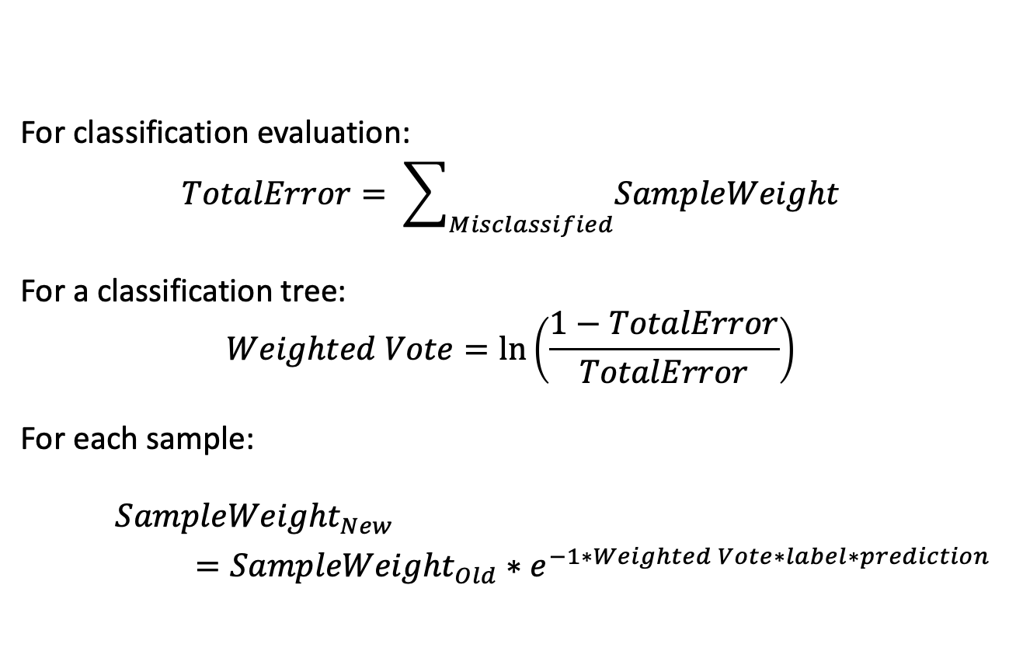
Re-weighting samples for classification
For classification evaluation:
$$TotalError= \sum_{Misclassified}{SampleWeight}$$
For a classification tree:
$$Weighted Vote=\ln\left(\frac{1−TotalError}{TotalError}\right)$$
For each sample:
${SampleWeight}_{New}$
$={SampleWeight}_{Old}∗e^{−1∗Weighted Vote∗label∗prediction}$
Notes:
병찬
분류 평가는 결국 mis class 가 없는 방향으로 가야 함(낮은 값으로..)
가장 마지막 공식은 기억할 필요가 없다.
가장 마지막 공식은 주로 label 과 prediction 이 cancel each other out 한다.

Slide 19
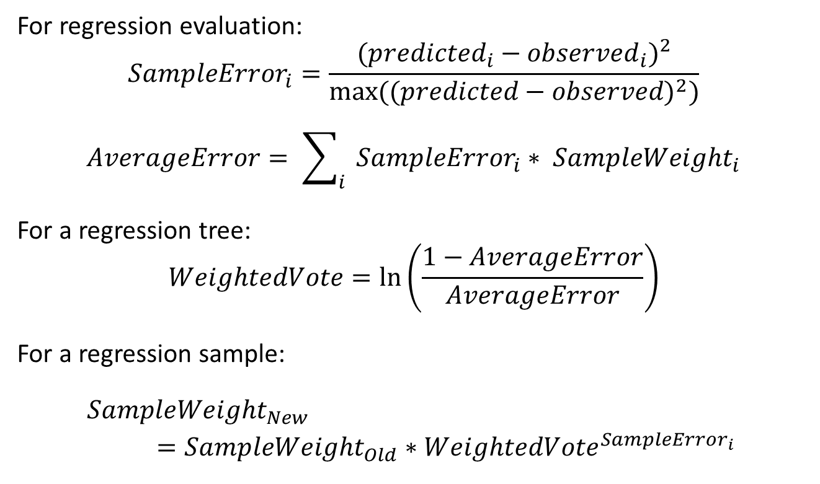
Re-weighting for regression
For regression evaluation:
$${SampleError}_{i}=\frac{{({predicted}_{i}−{observed}_{i})}^{2}}{max(({predicted−observed)}^{2})}$$
$$AverageError= \sum_{i}{{SampleError}_{i}∗ {SampleWeight}_{i}}$$
For a regression tree:
$$WeightedVote=\ln\left(\frac{1−AverageError}{AverageError}\right)$$
For a regression sample:
${SampleWeight}_{New}$
$={SampleWeight}_{Old}∗{WeightedVote}^{{SampleError}_{i}}$
Notes:
병찬
나누는거가 이건데 Max(predie) -> 맥시멈 파시블 에러라고 이해하자

Slide 20
Review
Components of a decision tree
Building a classification/regression tree
Pruning a tree to prevent overfitting
Ensembling trees through
Random Forest
Adaboost
Notes:
카훗 문제
[1,2,3,4] 에서 안되는건 사이즈가 다른건 bootstrap 에서 나올수 없는 예시임 [1,3,4] 가 안되는거임. 중복은 됨
Q. Random forest is an application of baggin. True or False => True
Adaboost is an application of boosting => True
bootstrapping is the first step of boosting => False
Bootstrapin is the fist stop of bagging
A stump splits a set into two children sets:[1,1,1,2] and [1,2,2]. Calculate weighted Gini Impurity.
Gini = 1 – sum of P^2
0.4 가 정답
First set = 1 – ( (3/4)^2 + (1/4)^2)
Second set = 1 – ( (1/3)^2 + (2/3)^)
4/7 * Fist set + 3/7 * Second set
4/7 은 전체가 7개인데 첫번째 set 에 4개가 있다는 가중치
3/7은 전체가 7개인데 두번째 set 에 3개가 있다는 가중치
5번문제에서 Variance 를 구하는 문제도 풀어보자
Variance = sum of (observed – avg)^2 / 개수
0.2 가 정답
First set = ( 3*(1-1.25)^2 + 1*(2-1.25)^2) / 4
Second set = ( 1*(1-1.67)^2 + 2*(2-1.67)^2) / 3
4/7 * Fist set + 3/7 * Second set
Which sample should get the highest weight for the next round in boosting?
Incorrectly predicted by an accurate learner. 가 정답

Slide 21
Homework
Programming Assignment 2 will be released on Wednesday

